Slide 1
Intro lesson
1
Greetings, names, follow simple instructions, identify and recognize 5 colours.
"Hello", "What's your name", "My name is...", "How are you?", "I’m fine, thank you", "Goodbye", "Give me..."
red, blue, green, yellow, purple, favorite, colour, stand up, sit down, hands up, hands down, jump, run, turn around, pass, touch.
The Hello Song (audio)
The Hello Song (video)
The Goodbye Song (audio)
The Goodbye Song (video)
All about me worksheet
Colour the cute fish worksheet
name tracing sheets (one for each student with their name in dots) - optional
coloured pencils
name tags for each student
a glove puppet
a small ball
5 sheets of origami coloured paper (red, green, blue, yellow, purple)
cushions (1 per student)
This lesson provides a good platform to begin the course with your young learners as it introduces them to the key stages and routines you will use in every class. At this age some of your students may be a bit shy at first so make sure you smile a lot and make them feel really welcome - they will soon gain confidence as you run through all the fun activities in this lesson!

Slide 2
Media in these slides
Songs
Interactive games
Readers
Printables
Vocabulary
Play audio or video directly from the slide
Play games and activities on the slide with your class
Read stories together on the slide or watch a video
View worksheets, craft sheets, etc. on screen
View lesson vocabulary images on screen
The hello song
The goodbye song
All about me worksheet
Colour the cute fish worksheet
5 colours: red, blue, green, purple, yellow

Slide 3
Hello!
- Introduction lesson -

Slide 4


The Hello Song
Song audio and video
only available to ESL KidStuff members.
Click here to remove message.
Song audio and video
only available to ESL KidStuff members.
Click here to remove message.
SAMPLE FOR EVALUATION
Join ESL KidStuff
to view without watermark.
Click to play song
Play song audio
Play song video

Slide 5


Click object to hear vocab
SAMPLE FOR EVALUATION
Join ESL KidStuff
to view without watermark.
5 colours
4 | © ESLKidStuff.com

Slide 6
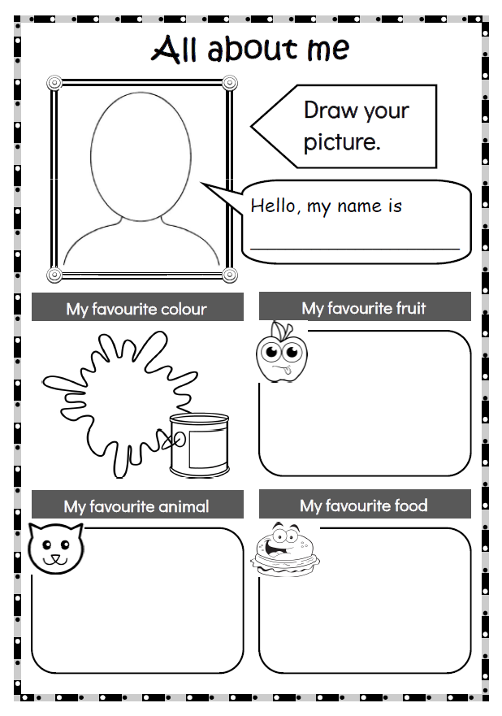
SAMPLE FOR EVALUATION
Join ESL KidStuff
to view without watermark.
All about me
5 | © ESLKidStuff.com

Slide 7
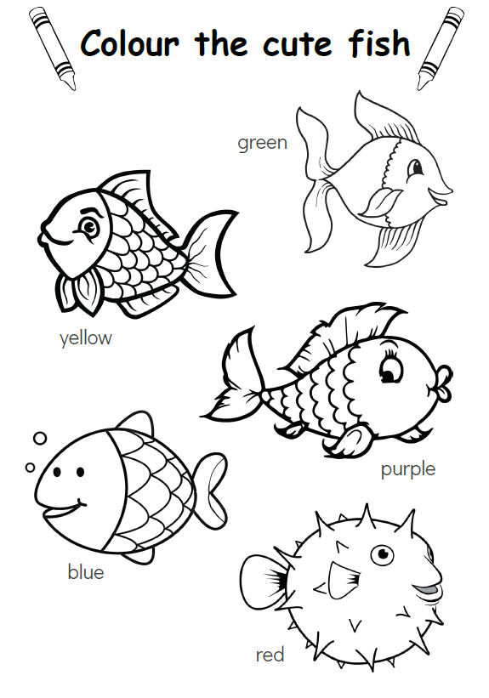
SAMPLE FOR EVALUATION
Join ESL KidStuff
to view without watermark.
Homework
6 | © ESLKidStuff.com

Slide 8
The Goodbye Song
Song audio and video
only available to ESL KidStuff members.
Click here to remove message.
Song audio and video
only available to ESL KidStuff members.
Click here to remove message.
SAMPLE FOR EVALUATION
Join ESL KidStuff
to view without watermark.
Click to play song
Play song audio
Play song video

Slide 9
SAMPLE FOR EVALUATION
Join ESL KidStuff
to view without watermark.

