Slide 1
Alphabet – a b c
1
Identify, recognize and print 3 lowercase letters.
a, b, c.
The ABC song (audio & video)
a-c flashcards
abc printing sheet
Blackboard / Whiteboard with chalk / markers
Use this mini-lesson within your main lesson for alphabet practice.
Audio is played for the letters and words. If you do not wish the audio to play, please mute your speakers.

Slide 2
a b c
- Lesson 1 -

Slide 3


Teacher’s notes are here on every lesson slide.
Sing “The ABC song” Start this section of the lesson with the ABC song to indicate that it’s alphabet time.
Bring everyone’s attention to this slide and play the song.
Encourage everyone to clap along as you sing – after a few classes everyone will be able to sing along with you.
Lyrics for “The ABC song”
A B C D E F G
H I J K L M N
O P Q R S T U
V W and X Y Z
I can sing my ABCs,
Won’t you sing along with me?
Repeat
The ABC song
a
c
e
g
b
d
f
j
m
Song audio and video
only available to ESL KidStuff members.
Click here to remove message.
n
i
h
Song audio and video
only available to ESL KidStuff members.
Click here to remove message.
k
l
SAMPLE FOR EVALUATION
Join ESL KidStuff
to view without watermark.
Click to play song
o
p
q
r
s
t
u
Play song audio
v
w
x
y
z
Play song video
2 | © ESLKidStuff.com
[ Press space bar or left-mouse click to move to the next slide ]

Slide 4


a
Alphabet letter introduction
1. Bring everyone's attention to the letter on this slide.
[ Press space – audio ]
2. Everyone repeats and choruses the letter 3x.
[ Press space ]
3. Say “is for ..."
[ Press space - audio ]
4. Everyone repeats and choruses the letter sound 3x.
[ Press space ]
5. Say “is for ..."
[ Press space ]
6. Show the picture - encourage students to say what it is, if they know.
[ Press space – audio ]
7. Everyone repeats and choruses the word 3x.
8. Quickly run through once more – point to the letter in the top-left and ask, “What’s this?” (elicit the letter). Say, “… is for?” and elicit the sound. Finally, point at the picture and say, “Is for?” and elicit the word.
a
a
is for
SAMPLE FOR EVALUATION
Join ESL KidStuff
to view without watermark.
/æ/
is for
apple
[ Press space bar to continue ]
[ Press space bar or left-mouse click to move to the next slide ]

Slide 5
Practice the letter
Here are some quick-fire activities you can use to practice a new letter. You don’t need to use all of these activities each time you teach a letter – just choose a couple. Use different activities for each letter you teach to keep things fun and interesting.
You will need to download and print the flashcard letters before the lesson.
Give and give back
Give a letter flashcard to a student and get him/her to say the letter, sound and picture before passing back to you. Then do the same with some other students.
Pass it
Sit with your students in a circle. Hold up a flashcard letter and say the letter (e.g. “a”). Pass it on to the next student who also says it and passes it on to the next student.
Pick it up
Put the letter flashcard on the floor and ask individual students to pick it up, say the name, sound and picture and then put it back down again.
SAMPLE FOR EVALUATION
Join ESL KidStuff
to view without watermark.
Write on the board
After teaching a letter, give a chalk / marker pen to a student and ask him/her to write the letter onto the board as large as they can. You can have more than one student do this.
Magic finger
Hold a flashcard letter up in front of each student and let them trace the letter on the card with their 'magic' finger. Then the teacher, using his/her magic finger, traces the letter in the air and the students follow suit. The teacher and the students can then use their magic fingers to trace the letter on all sorts of fun places. For example, "Draw ‘a' on your hand. Now on the floor.
Now on your partner's back. Now on your cheek. Now on the wall. Now on your foot“, etc.
[ Press space bar or left-mouse click to move to the next slide ]

Slide 6

b
Alphabet letter introduction
1. Bring everyone's attention to the letter on this slide.
[ Press space – audio ]
2. Everyone repeats and choruses the letter 3x.
[ Press space ]
3. Say “is for ..."
[ Press space - audio ]
4. Everyone repeats and choruses the letter sound 3x.
[ Press space ]
5. Say “is for ..."
[ Press space ]
6. Show the picture - encourage students to say what it is, if they know.
[ Press space – audio ]
7. Everyone repeats and choruses the word 3x.
8. Quickly run through once more – point to the letter in the top-left and ask, “What’s this?” (elicit the letter). Say, “… is for?” and elicit the sound. Finally, point at the picture and say, “Is for?” and elicit the word.
b
b
is for
SAMPLE FOR EVALUATION
Join ESL KidStuff
to view without watermark.
/b/
is for
ball
[ Press space bar to continue ]
[ Press space bar or left-mouse click to move to the next slide ]

Slide 7
Practice the letter
Here are some quick-fire activities you can use to practice a new letter. You don’t need to use all of these activities each time you teach a letter – just choose a couple. Use different activities for each letter you teach to keep things fun and interesting.
You will need to download and print the flashcard letters before the lesson.
Give and give back
Give a letter flashcard to a student and get him/her to say the letter, sound and picture before passing back to you. Then do the same with some other students.
Pass it
Sit with your students in a circle. Hold up a flashcard letter and say the letter (e.g. “a”). Pass it on to the next student who also says it and passes it on to the next student.
Pick it up
Put the letter flashcard on the floor and ask individual students to pick it up, say the name, sound and picture and then put it back down again.
SAMPLE FOR EVALUATION
Join ESL KidStuff
to view without watermark.
Write on the board
After teaching a letter, give a chalk / marker pen to a student and ask him/her to write the letter onto the board as large as they can. You can have more than one student do this.
Magic finger
Hold a flashcard letter up in front of each student and let them trace the letter on the card with their 'magic' finger. Then the teacher, using his/her magic finger, traces the letter in the air and the students follow suit. The teacher and the students can then use their magic fingers to trace the letter on all sorts of fun places. For example, "Draw ‘a' on your hand. Now on the floor.
Now on your partner's back. Now on your cheek. Now on the wall. Now on your foot“, etc.
[ Press space bar or left-mouse click to move to the next slide ]

Slide 8

c
Alphabet letter introduction
1. Bring everyone's attention to the letter on this slide.
[ Press space – audio ]
2. Everyone repeats and choruses the letter 3x.
[ Press space ]
3. Say “is for ..."
[ Press space - audio ]
4. Everyone repeats and choruses the letter sound 3x.
[ Press space ]
5. Say “is for ..."
[ Press space ]
6. Show the picture - encourage students to say what it is, if they know.
[ Press space – audio ]
7. Everyone repeats and choruses the word 3x.
8. Quickly run through once more – point to the letter in the top-left and ask, “What’s this?” (elicit the letter). Say, “… is for?” and elicit the sound. Finally, point at the picture and say, “Is for?” and elicit the word.
c
c
is for
SAMPLE FOR EVALUATION
Join ESL KidStuff
to view without watermark.
/k/
is for
crayon
[ Press space bar to continue ]
[ Press space bar or left-mouse click to move to the next slide ]

Slide 9
Practice the letter
Here are some quick-fire activities you can use to practice a new letter. You don’t need to use all of these activities each time you teach a letter – just choose a couple. Use different activities for each letter you teach to keep things fun and interesting.
You will need to download and print the flashcard letters before the lesson.
Give and give back
Give a letter flashcard to a student and get him/her to say the letter, sound and picture before passing back to you. Then do the same with some other students.
Pass it
Sit with your students in a circle. Hold up a flashcard letter and say the letter (e.g. “a”). Pass it on to the next student who also says it and passes it on to the next student.
Pick it up
Put the letter flashcard on the floor and ask individual students to pick it up, say the name, sound and picture and then put it back down again.
SAMPLE FOR EVALUATION
Join ESL KidStuff
to view without watermark.
Write on the board
After teaching a letter, give a chalk / marker pen to a student and ask him/her to write the letter onto the board as large as they can. You can have more than one student do this.
Magic finger
Hold a flashcard letter up in front of each student and let them trace the letter on the card with their 'magic' finger. Then the teacher, using his/her magic finger, traces the letter in the air and the students follow suit. The teacher and the students can then use their magic fingers to trace the letter on all sorts of fun places. For example, "Draw ‘a' on your hand. Now on the floor.
Now on your partner's back. Now on your cheek. Now on the wall. Now on your foot“, etc.
[ Press space bar or left-mouse click to move to the next slide ]

Slide 10
Check the 3 letters
Run quickly through the letters, sounds and pictures by clicking the
[ space bar ].
Have everyone chant along as you go through them.
Let’s check
a
b
c
SAMPLE FOR EVALUATION
Join ESL KidStuff
to view without watermark.
a
b
c
is for
is for
is for
/æ/
/b/
/k/
is for
is for
is for
apple
ball
crayon
[ Press space bar or left-mouse click to move to the next slide ]

Slide 11
Review letters with games
Let’s play a couple of quick games to reinforce these letters. In future lessons you can include previously leaned letters as well.
These games can be rotated each week.
Hold it up
Give out all the letter flashcards to the students. Each student can have more than one letter. Say a letter and the student holding that card must hold it up in the air. Variation: say different actions as well - the student holding the card must do them, e.g. “The student with card “a”, jump 5 times!”
Letter touch
Place the alphabet letter cards, face-up, on the floor. Students sit in a circle around the cards. Tell everyone to hold up their hands. The teacher then says a letter and the students must race to touch that letter first. The person who touches the letter first picks up the card and keeps it. At the end of the game, the
student with the
most letter cards
is the winner.
Find it
Hold up a letter flashcard and the students search around the room for an object beginning with that letter. (e.g. a - arm, b - book, c - clock).
SAMPLE FOR EVALUATION
Join ESL KidStuff
to view without watermark.
Slow motion
Hold the pack of alphabet flashcards with the letters facing towards yourself. The first letter card should be turned around, so the letter is facing the students but is hidden as it is behind the pack. Slowly pull the flashcard up inch by inch so the students can only see part of the letter. As the letter is slowly revealed, students try to guess
what it is. The first student to guess
correctly keeps the card (for
1 point). Variation: to make
it a little more difficult, turn
each letter flashcard upside
down.
Vanishing alphabet flashcards
Stick the flashcard letters to the board. Tell everyone to close their eyes. Take away one of the flashcards and then tell your students to open their eyes again. The first student to shout out
the missing letter
can keep that
flashcard.
At the end of the
game, the student
with the most letter
cards is the winner.
[ Press space bar or left-mouse click to move to the next slide ]

Slide 12
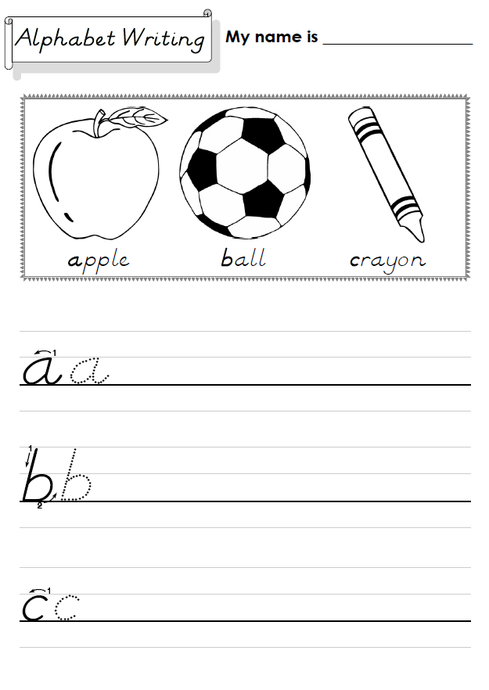
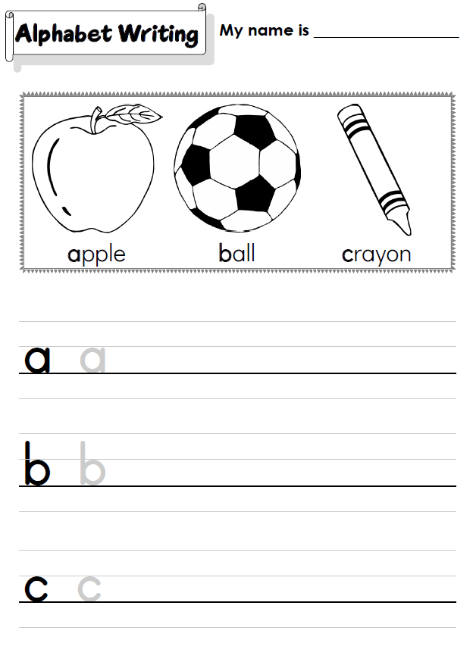

Do the “abc printing sheet”
We’ll finish with some printing practice.
Hold up the worksheet and model tracing and printing each letter. Clearly show the directions of printing each letter and emphasize the importance of staying on the line.
Have your students work on their worksheets. Spend time with each student helping, asking what the letter is, and praising.
The printing sheet is available in clear print letters or D’Nealian script. D'Nealian is a style of writing in cursive and print (block) handwriting.
Click to see
SAMPLE FOR EVALUATION
Join ESL KidStuff
to view without watermark.
Regular printing sheet
D’Nealian printing sheet
11 | © ESLKidStuff.com
[ Press space bar or left-mouse click to move to the next slide ]

Slide 13
SAMPLE FOR EVALUATION
Join ESL KidStuff
to view without watermark.

