Slide 1
Penguins at home
3
Pronouns and personal details

Slide 2
a pen
a pencil
a notebook
colored pencils

Slide 3
1
Find out about Polly the Penguin
Say what Polly and Peter can do
Review the letters of the English alphabet
2
3
4
Read about penguins
SAMPLE FOR EVALUATION
Join ESL KidStuff
to view without watermark.
[ Press space bar or left-mouse to continue ]

Slide 4

How do you spell that?
Writing review
SAMPLE FOR EVALUATION
Join ESL KidStuff
to view without watermark.
Notes:
The video is a short YouTube clip of Peter the Puffin. It is not necessary for the lesson, but is a nice feature to show if possible.

Slide 5
Ready for writing
Use a pencil.
a
j
s
Copy this table.
b
k
t
eɪ | iː | e | aɪ | əʊ | uː | ɑː
a | b | f | i | o | q | r
_ | _ | _ | _ |  | u
j | d | _ |  |  | _
_ | e | n
 | _ | s
 | _ | x
 | _ | _
 | v
Listen to the sounds of the letters.
c
l
u
Listen to your teacher say the letters.
d
m
v
SAMPLE FOR EVALUATION
Join ESL KidStuff
to view without watermark.
e
n
w
f
o
x
Write the letters in the right places in the table.
g
p
y
Say the letters.
h
q
z
i
r

Slide 6
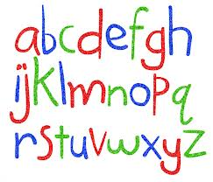
Ready for writing - KEY
Check you have the letters in the right places in the chart.
eɪ | iː | e | aɪ | əʊ | uː | ɑː
a
b
f
i
o
q
r
Say the letters of the alphabet.
h
c
l
y
u
Work with a partner.
Student A: Find 5 English words. Spell them to Student B.
Student B: Write down the letters that Student A says. Then check your answers.
Finally, switch roles.
j
d
m
w
SAMPLE FOR EVALUATION
Join ESL KidStuff
to view without watermark.
k
e
n
g
s
p
x
t
z
v

Slide 7
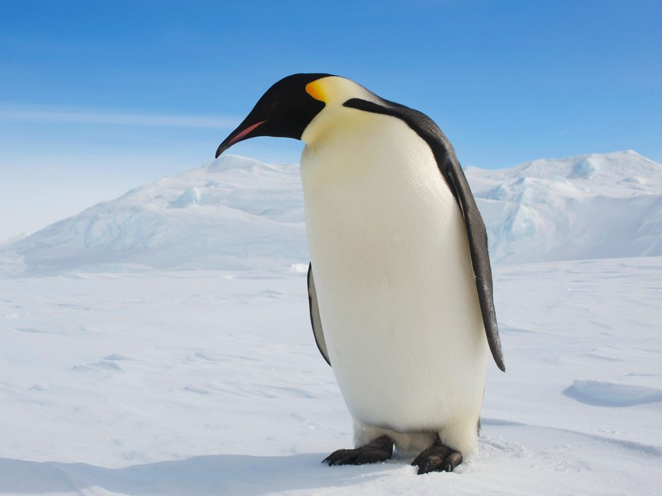
Meet Polly
Polly the Penguin
SAMPLE FOR EVALUATION
Join ESL KidStuff
to view without watermark.
Polly
Hello there.
Nice to meet you!
I’m Polly. That’s P-O-L-L-Y!
Notes:
The video is a short YouTube clip of Peter the Puffin. It is not necessary for the lesson, but is a nice feature to show if possible.

Slide 8
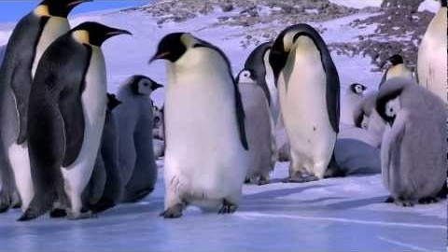

About Polly
I know a bird
That cannot fly:
Polly Penguin is its name.
It cannot fly,
But it can swim
With speed that wins it fame!
I know a bird
That lives on ice
And waddles by the sea.
It looks so cute
In its black-and-white suit,
As handsome as can be!
SAMPLE FOR EVALUATION
Join ESL KidStuff
to view without watermark.
i
Notes:
An internet connection is required to view this YouTube video. The video is a funny clip about penguins. It is not necessary for the lesson, but is a nice feature to show if possible.

Slide 9
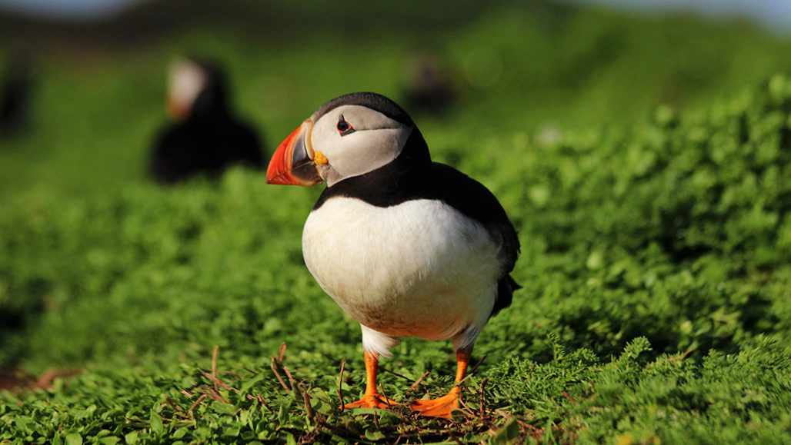
Remember Peter!
His first name is Peter.
His last name is Puffin.
Peter is two years old.
He lives on an island.
His favorite color is blue.
Peter likes the sea.
SAMPLE FOR EVALUATION
Join ESL KidStuff
to view without watermark.
Hello Peter.
Nice to see you again.

Slide 10

Grammar corner
Pronouns
His first name is Peter.
His last name is Puffin.
Peter is two years old.
He lives on an island.
His favorite color is blue.
Peter likes the sea.
Write a word in each space in the text.
SAMPLE FOR EVALUATION
Join ESL KidStuff
to view without watermark.
Her first name is Polly.
______ last name is Penguin.
______ is four years old.
______ lives in the Antarctic.
______ favorite color is orange.
Orange is the color of the sun.
______ likes the sun.

Slide 11

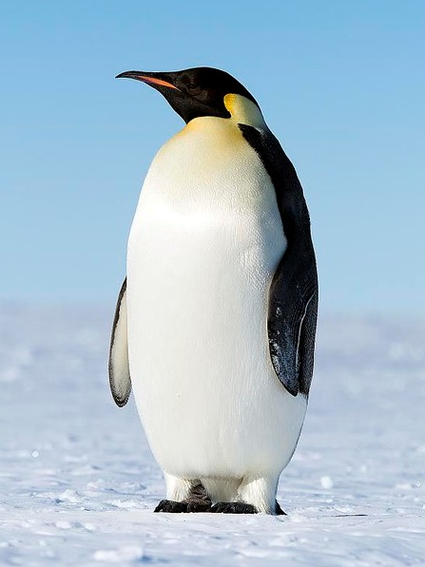
About Polly
Answer these questions about Polly.
What is her first name?
What is her last name?
How old is she?
Where does she live?
What’s her favorite color?
What does she like?
SAMPLE FOR EVALUATION
Join ESL KidStuff
to view without watermark.

Slide 12

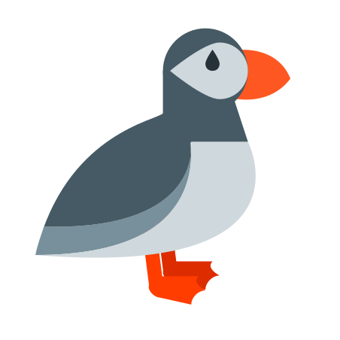
Take some notes
Her first name’s ______. Her last name’s ______. She lives in________ . She’s _____ years old. She likes ________ and _______. Her favorite color is _______.
Say something about Peter and Polly.
His first name’s Peter…
SAMPLE FOR EVALUATION
Join ESL KidStuff
to view without watermark.
Polly
Penguin
the Antarctic
4
the sun … fish
orange
Write words to put in each space in the text.
Her first name’s Polly…

Slide 13
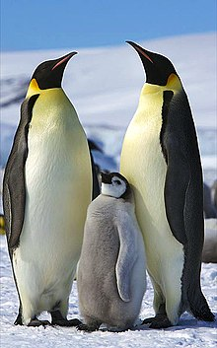
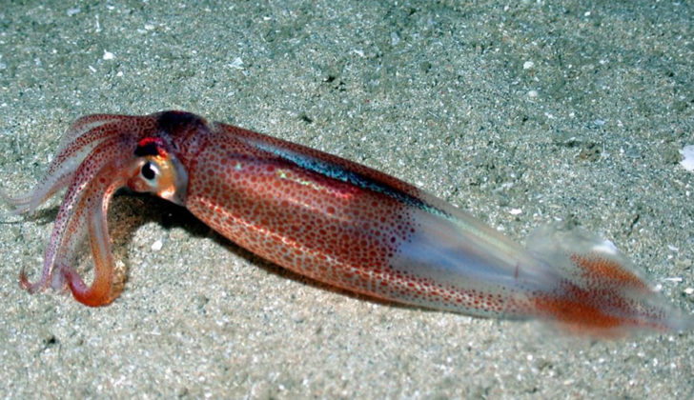
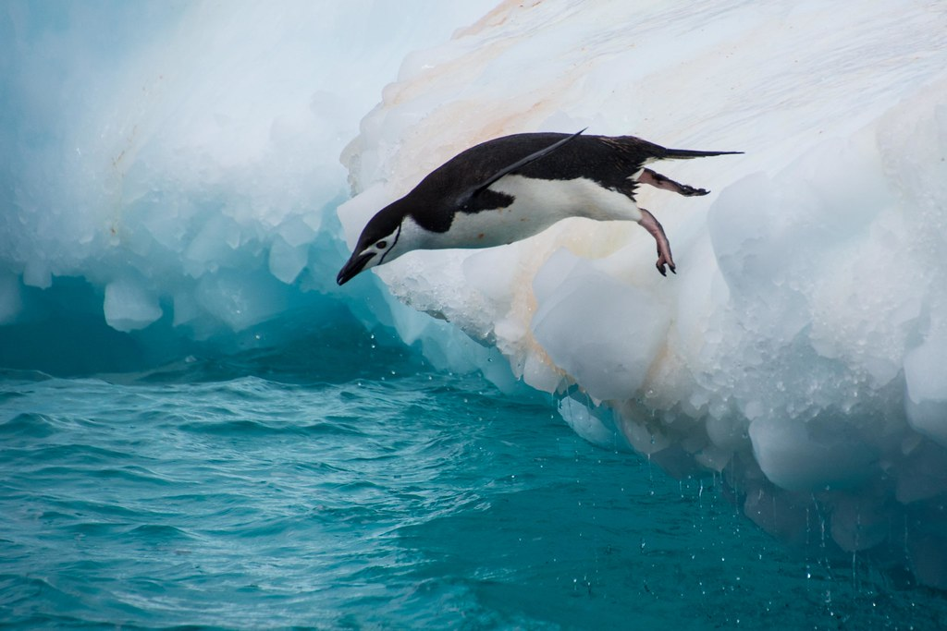
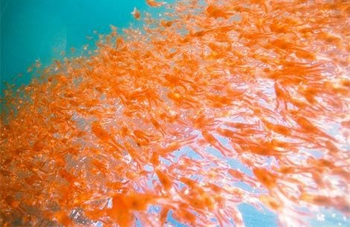
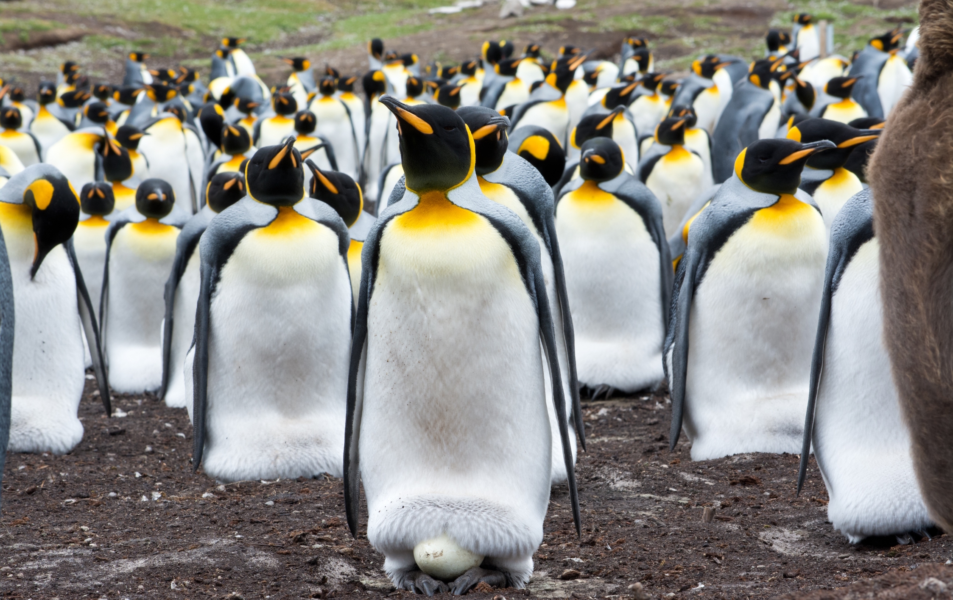
Penguins live in Antarctic and along the coasts of southern Africa and America. They spend their time on the ice in winter and on rocks in summer. On land they can waddle and hop.
Read and match
Answer the questions from the texts.
What are penguins?
Penguins eat fish, krill and squids. Their legs are short and they have webbed feet. They have flippers - not wings and catch their food in the sea.
Where do penguins live?
What can penguins do?
SAMPLE FOR EVALUATION
Join ESL KidStuff
to view without watermark.
A baby penguin is called a chick. The eggs hatch in December when it is warm in Antarctica. Penguins live in groups called colonies to protect their eggs and chicks. They can live up to 20 years.
What are baby penguins called?
Penguins are birds but they can’t fly. They have got white grey and black feathers but they haven’t got wings. They can swim and they can dive.
[ Press space to see the answers ]

Slide 14
1
Find out about Polly the Penguin
Say what Polly and Peter can do
Review the letters of the English alphabet
2
3
4
Read about penguins
SAMPLE FOR EVALUATION
Join ESL KidStuff
to view without watermark.

Slide 15
Thank you!
SAMPLE FOR EVALUATION
Join ESL KidStuff
to view without watermark.
Do you have any questions?

